Slide 1
COVID-19 UPDATE
Board of County Commissioners
Alina M. Alonso, M.D.
Director
DOH-Palm Beach
July 7, 2020

Slide 2
Total COVID Cases Florida
Notes:
As all of us have heard, Florida remains the state with the largest increasing new COVID cases in the nation.
The State Surgeon General, Dr. Rivkkees, in consultation with the Governor, announced 1)the need for the use of facial masks at all times in public and where physical distancing was not possible 2) all above age 65 and those with high risk to stay in home 3)all individual refrain from participating in groups greater than 50.
Florida has seen an increase of 6,336 new cases and an additional 47 deaths since yesterday. This does not compare to the spike of 7/3 of 11,436 but is significant in term of a high number of deaths compared to the previous spike on 6/23 which was 50 deaths. Again keep in mind that the idea to ride this out is that we can keep our hospital without surge and protect those who are most at risk for death. We all acknowledge the death rate lags by about 6 weeks to a rise in numbers.

Slide 3
10 states with the most COVID cases
1. New York: 397,131 cases
2. California: 264,681 cases
3. Florida: 200,111 cases
4. Texas: 194,932 cases
5. New Jersey: 173,402 cases
6. Illinois: 147,251 cases
7. Massachusetts: 109,974 cases
8. Arizona: 98,103 cases
9. Georgia: 95,516 cases
10. Pennsylvania: 94,403 cases
Source: FOX News.com

Slide 4
Total COVID Cases for PB County
3173
2806
2486
2518
2183
1,888
1,746
1,660
1,450
1342
1002
624
1392
799
298
946
761
551
380
154
Notes:
There is an increase of 402 new cases and one new death. Please, notice that deaths are placed on the date of death and this makes this add or delete the numbers which some are saying they are changing the numbers.
Notice our age distribution. The most obvious answer to this move in the age of positivity is the physical distancing being observed by the elderly and the disregard of the higher risk taking behavior of the younger population.

Slide 5
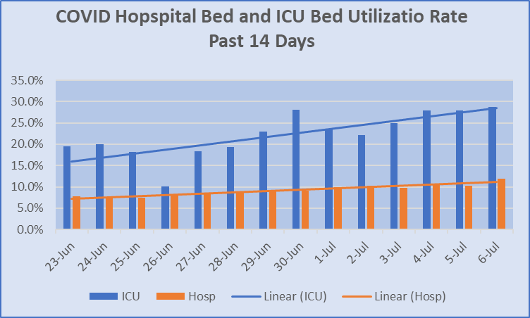

Slide 6
Pediatric COVID Characteristics

Slide 7
PBC COVID Testing and Positivity
13.20 %
Notes:
Our Total People Tested Positivity and our Lab Positivity continues to climb confirming that the virus continues to gain strength in the county as well as our surrounding counties and the rest of the state. Last BCC total positivity at 8.8% and Labs at 10.75%

Slide 8
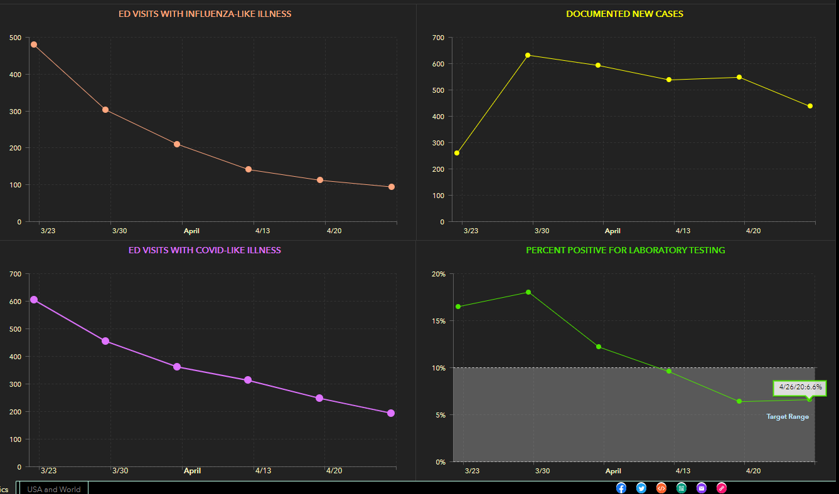
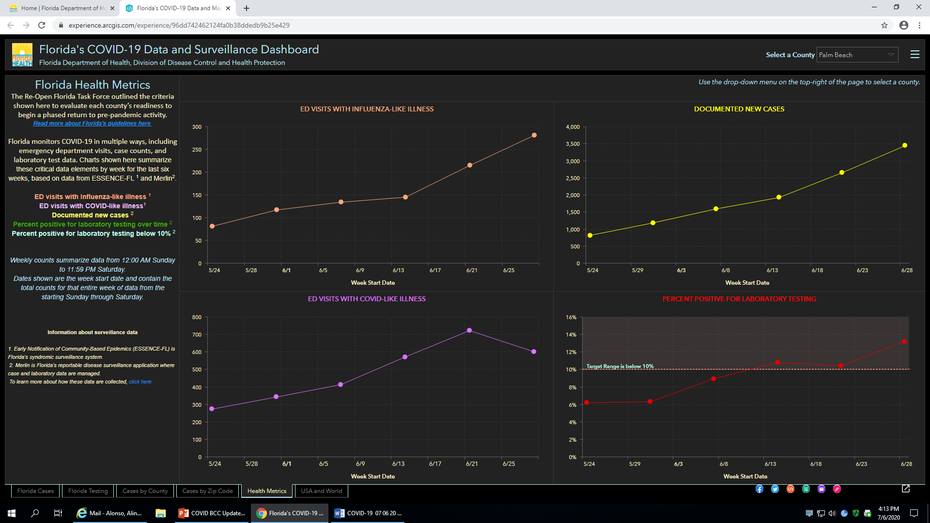
Health Metrics for Palm Beach County
Before Opening
Now
Notes:
ED VISITS WITH INFLUENZA-LIKE ILLNESS DOCUMENTED NEW CASES
ED VISITS WITH COVID-LIKE ILLNESS PERCENT POSITIVE FOR LABORATORY TESTING

Slide 9
Re-Opening Plan for Florida
The Re-Open Florida Task Force Executive Committee Report was submitted to Governor DeSantis. Click here to view the Safe. Smart. Step-by-Step. Plan for Florida’s Recovery Report.

Slide 10
Questions?
Thank You

